Slide 1

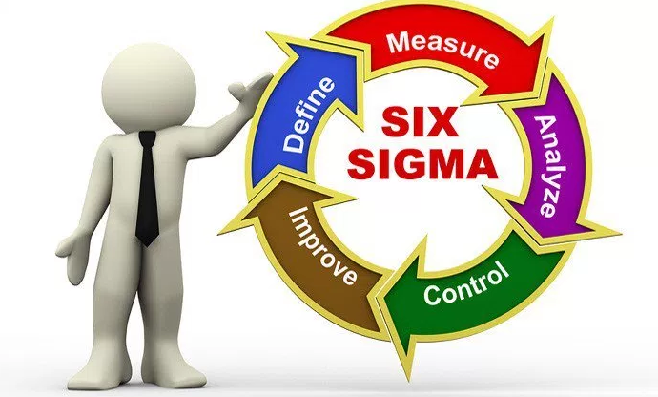

Introduction to Six Sigma
المعهد التكنولوجى لهندسة التشييد و الإدارة
Prepared By:
Said Fawzy
Manager of Information Center –Quality manager
Tendering Department
Arab Contractors

Slide 2
Chapter 01 :
Introduction

Slide 3
How Variation
Impact You ?

Slide 4





Order1: 25min
Order2: 23min
Order3: 28min
Deliver Pizza
In less than 30 min
Which one
you chose ?
Order1: 10min
Order2: 20min
Order3: 60min
Deliver Pizza
In Average of 30 min

Slide 5


Slide 6
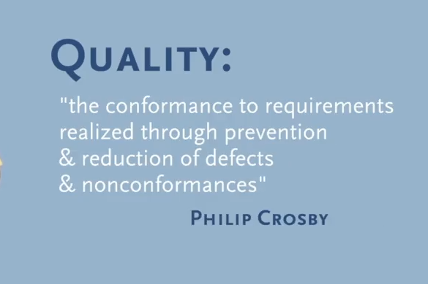

Slide 7
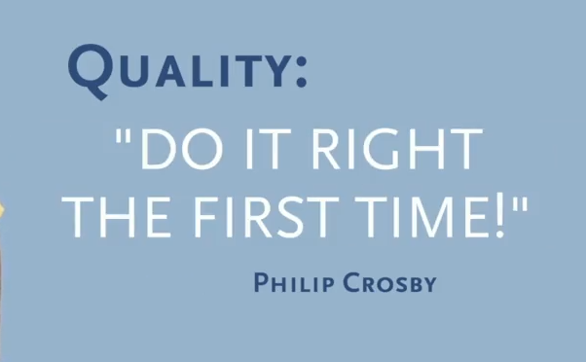

Slide 8
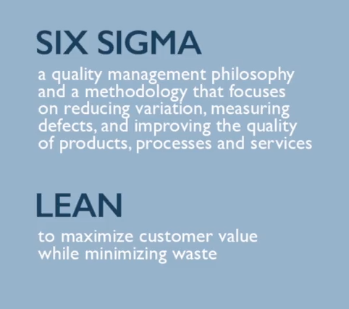

Slide 9
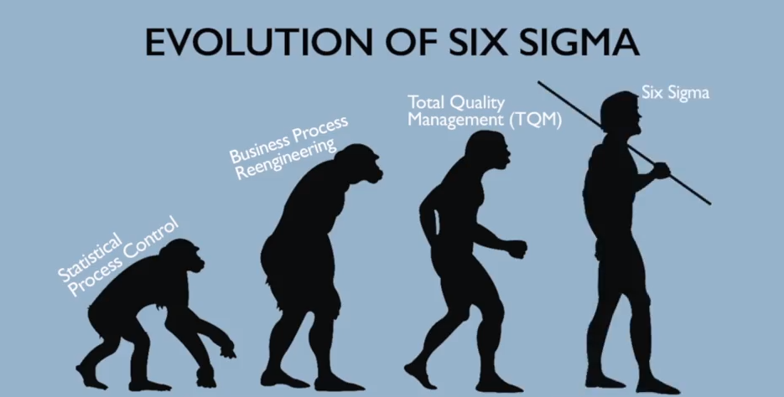

Slide 10
Instead of being problem driven,
we need to be customer driven.
We should search for ways to prevent issues and dissatisfaction

Slide 11
Instead of reacting to issues and
dissatisfaction
We should search for ways to prevent issues and dissatisfaction

Slide 12
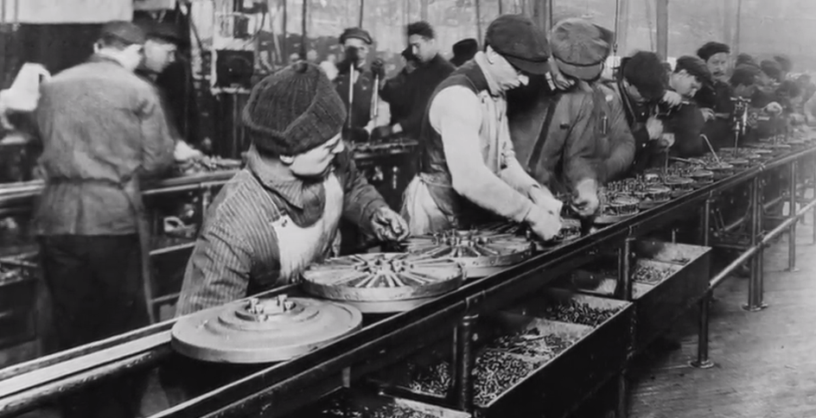
Ford Assembly line

Slide 13
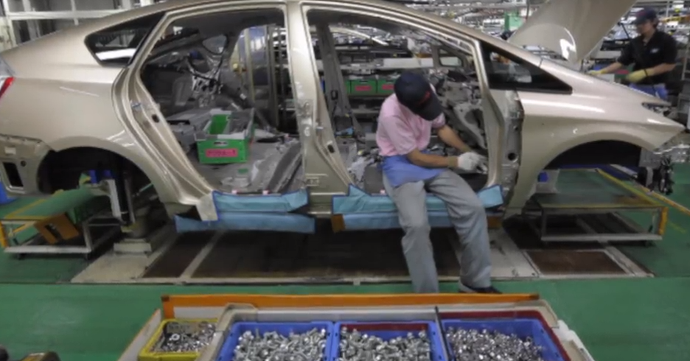
Toyota Assembly line

Slide 14
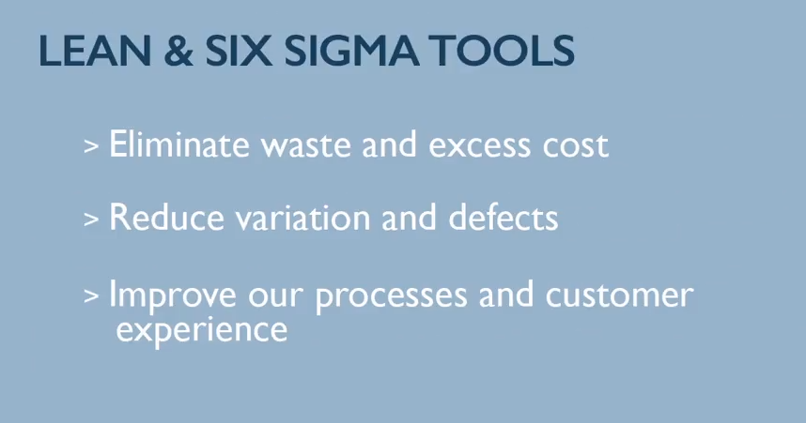

Slide 15
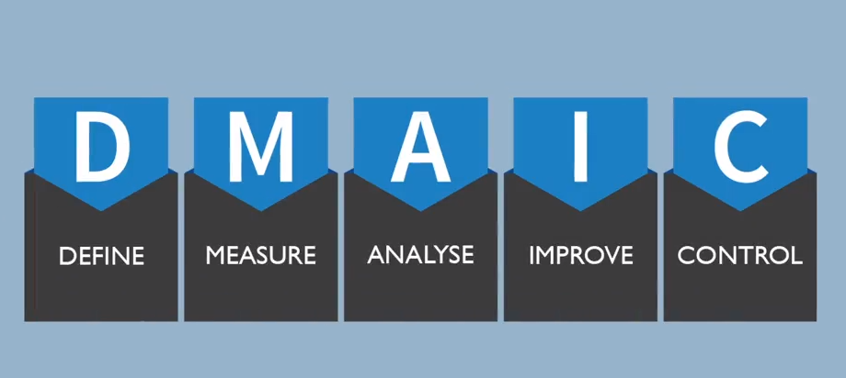

Slide 16

Do you think
Is Great ?

Slide 17


Slide 18
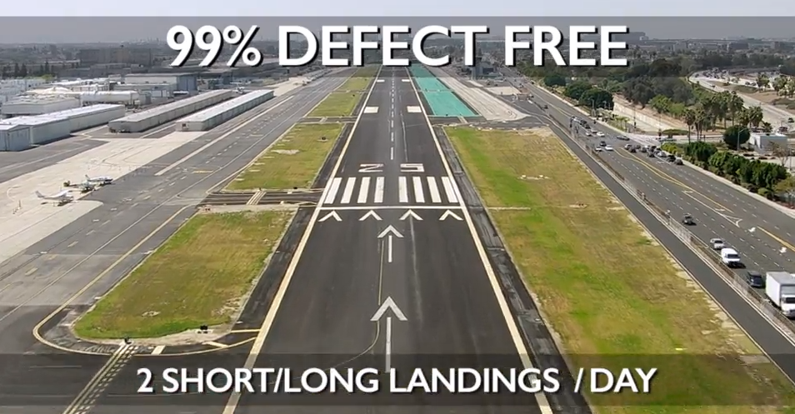

Slide 19


Slide 20


Slide 21


Slide 22


Slide 23


Slide 24


Slide 25
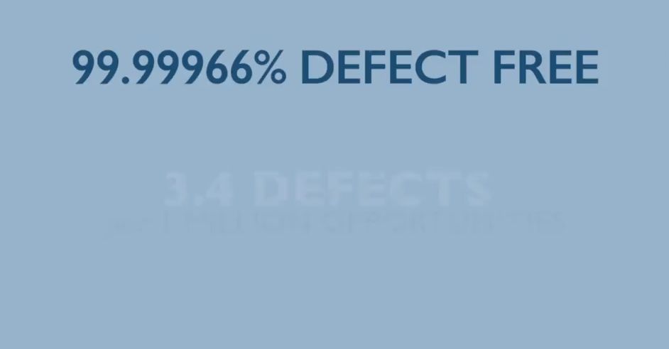


Slide 26
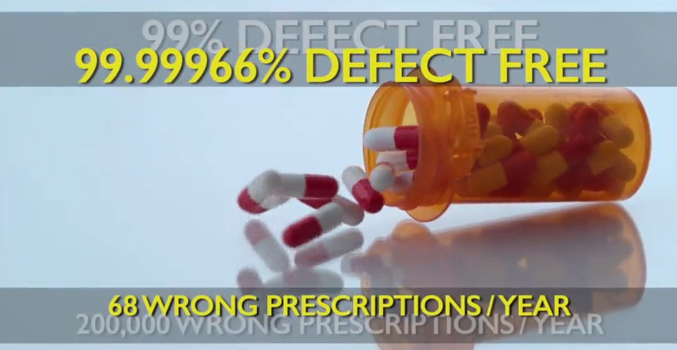

Slide 27
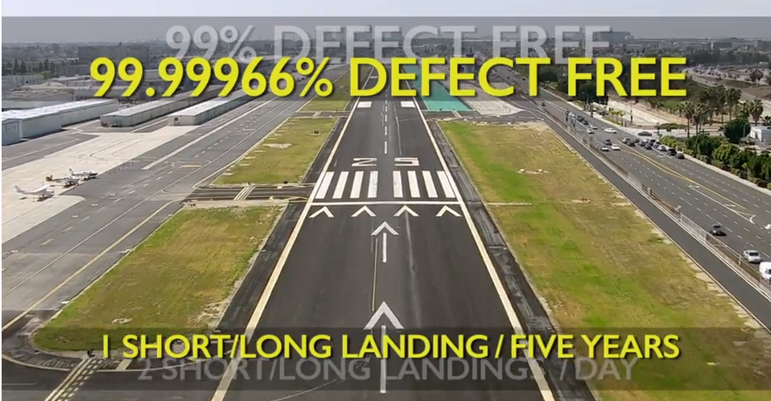

Slide 28


Slide 29


Slide 30


Slide 31


Slide 32
Chapter 02 :
Background and Meaning
Of Six Sigma

Slide 33
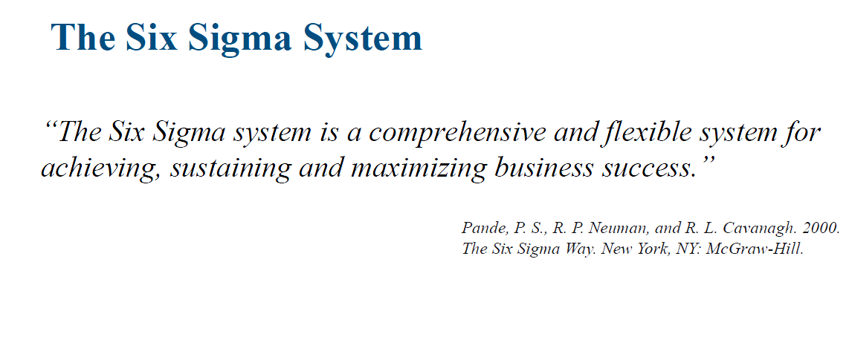

Slide 34




Comprehensive and
flexible system
For achieving
Sustaining and Maximizing Business Success

Slide 35

How do Six Sigma Achieve this ?
Careful understanding of customer needs,

Slide 36

How do Six Sigma Achieve this ?
Use of facts through data collection and
statistical analysis

Slide 37
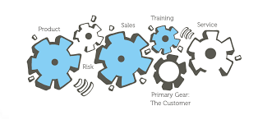
How do Six Sigma Achieve this ?
By managing, improving and re-engineering production, as well as business processes, to increase customer satisfaction and business excellence.

Slide 38
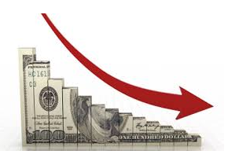

What is Business Excellence means?
Cost Reduction
Productivity improvement

Slide 39
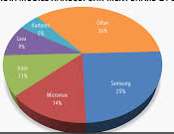
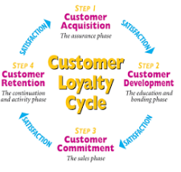
What is Business Excellence means?
growth of market share
customer retention cycle

Slide 40


What is Business Excellence means?
time reduction
defect reduction

Slide 41

What is Business Excellence means?
change to quality culture

Slide 42
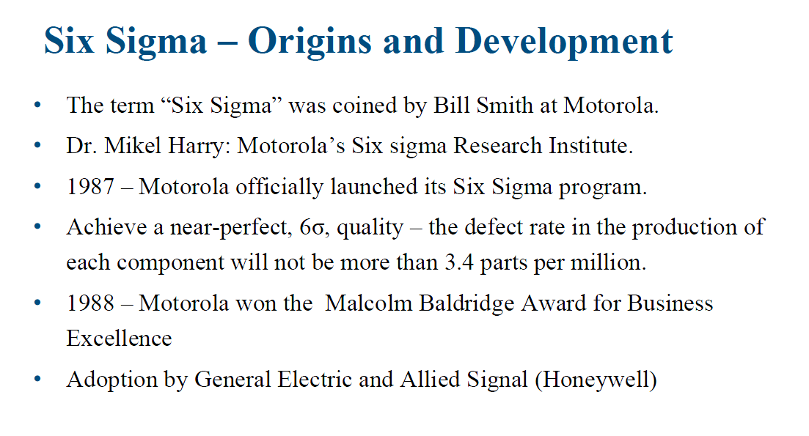

Slide 43

Six Sigma –Origin and development:
In the late 1970s, Motorola started experimenting with problem solving, through statistical analysis and started using the Six Sigma approach in the 1980s, to achieve one of its top corporate goals of improving quality.

Slide 44
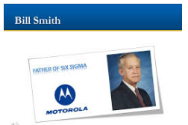
Six Sigma –Origin and development:
The engineer Bill Smith, called the father of Six Sigma is widely credited, with recognizing that a process mean, so the process centering could not be maintained exactly on target. And that for complex products, the product variability had to be controlled, to higher limits and was previously accepted.

Slide 45
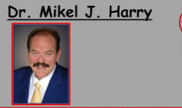
Six Sigma –Origin and development:
With Dr. Mikel Harry, who was responsible for the development of the Six Sigma implementation strategy and deployment guidelines, Six Sigma was implemented at Motorola.

Slide 46

Six Sigma –Origin and development:
And in 1990, Dr. Harry founded and directed Motorola six Sigma Research Institute

Slide 47

Six Sigma –Origin and development:
In 1987, though it was the official birth of the Six Sigma Motorola methodology in Motorola and this is for the communication sector uses an approach to track and compare performance, against the customer requirements and to achieve an ambitious target, target of near perfect Six Sigma quality in the products produced.

Slide 48
Six Sigma –Origin and development:
Now, in the late 1980s, this process helped the company to achieve enormous improvements in quality, for example

Slide 49
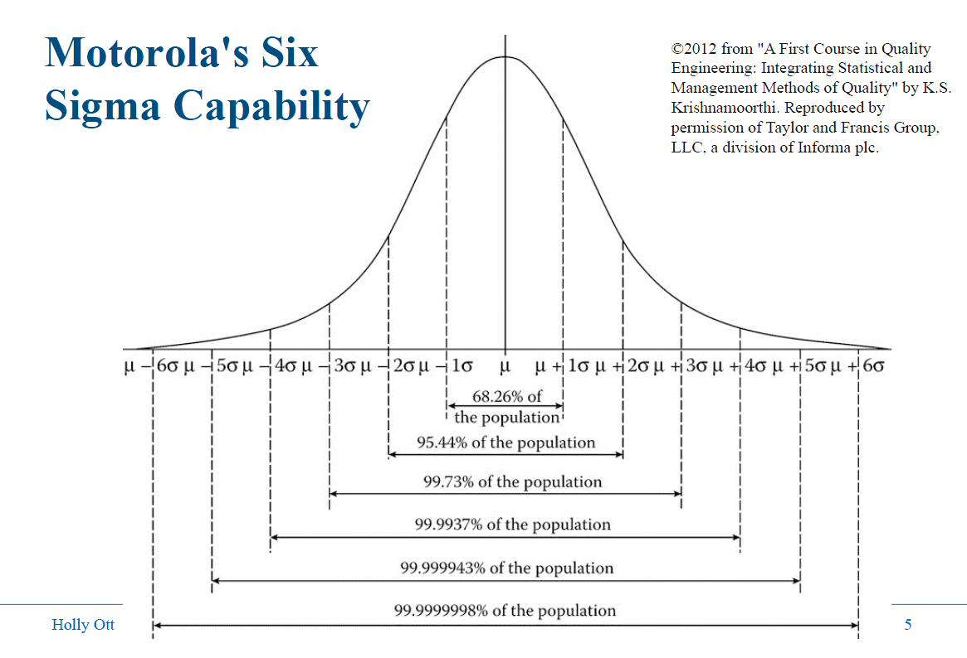

Slide 51
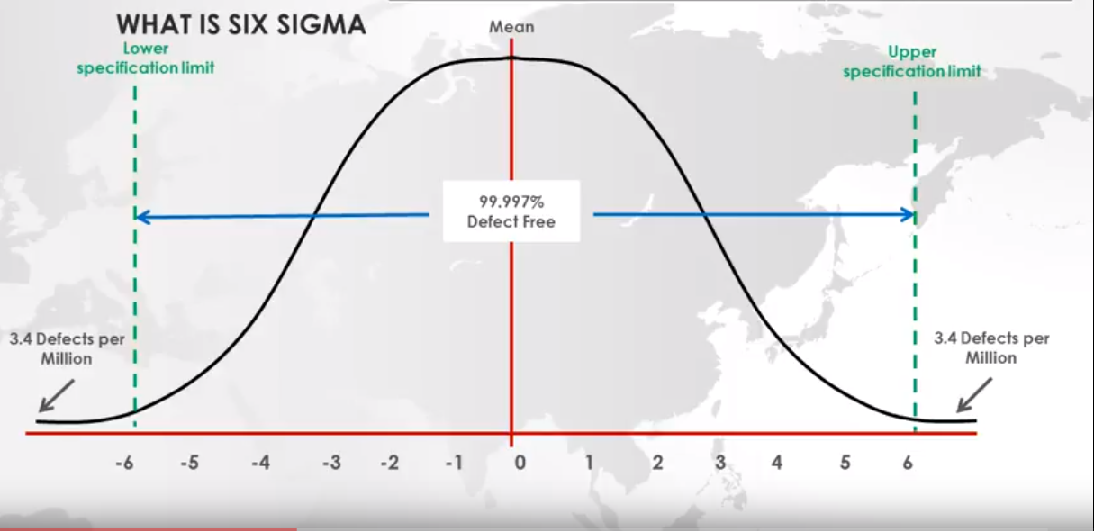

Slide 52
Order1: 25min
Order2: 23min
Order3: 28min
Deliver Pizza
In less than 30 min
Which one
you chose ?
Order1: 10min
Order2: 20min
Order3: 60min
Deliver Pizza
In Average of 30 min

Slide 53


Slide 54


Slide 55
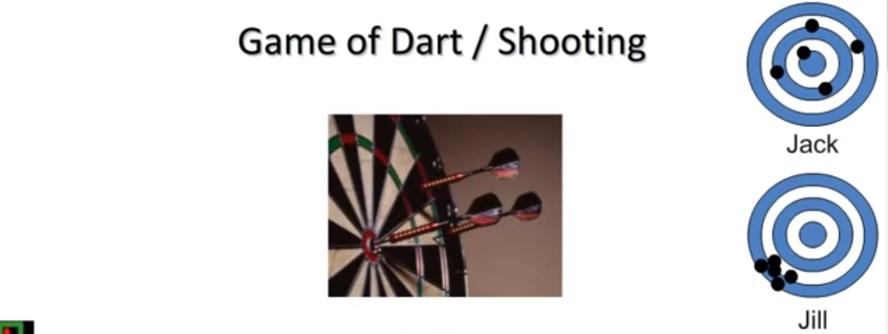

Slide 56
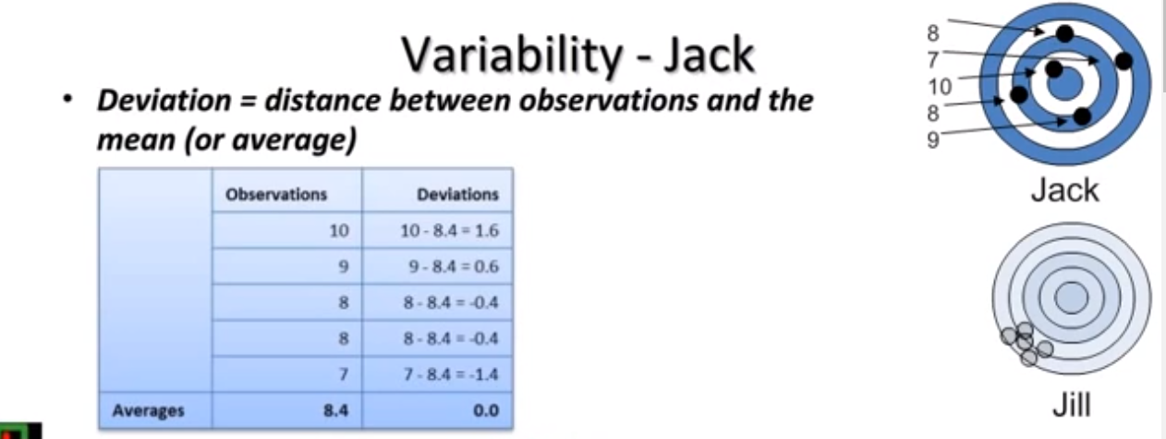

Slide 57
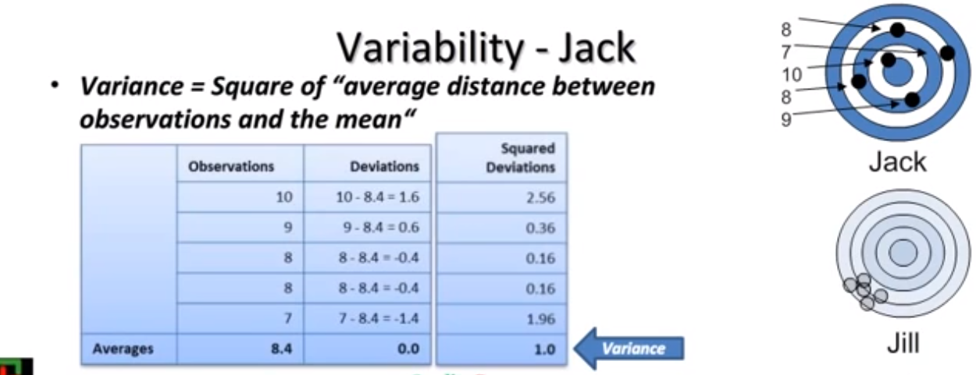

Slide 58
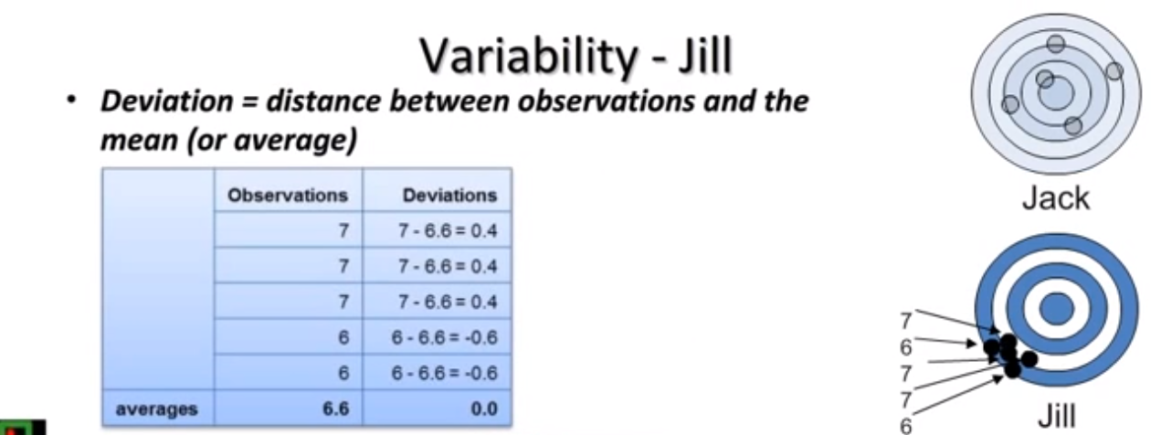

Slide 59
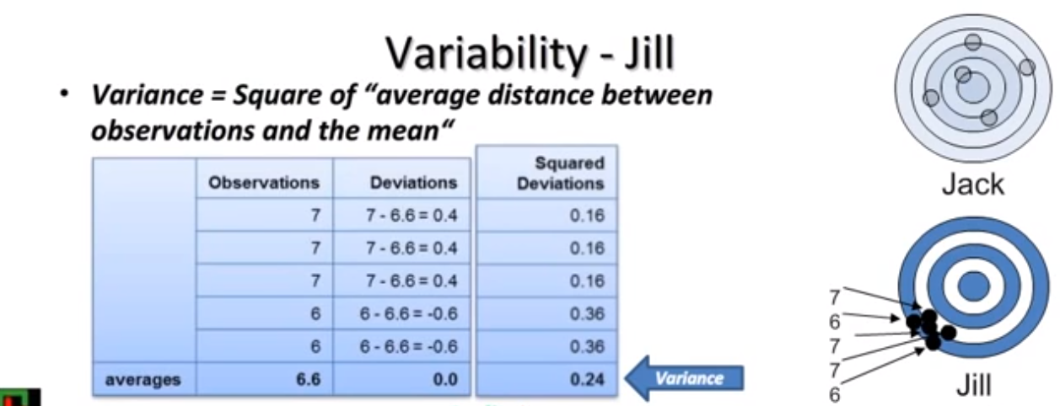

Slide 60
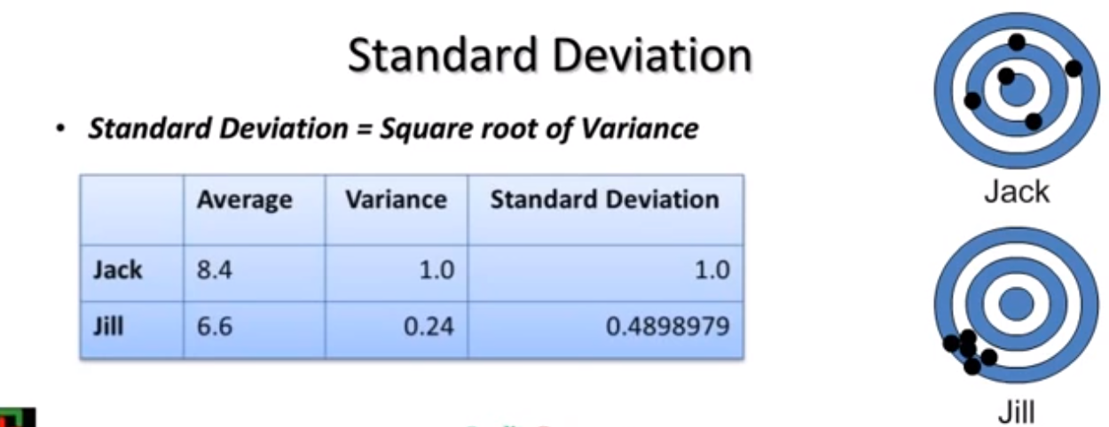

Slide 61
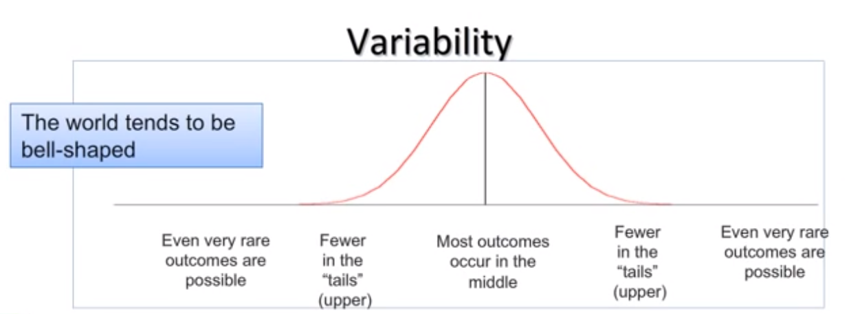

Slide 62

Student marks at school

Slide 63
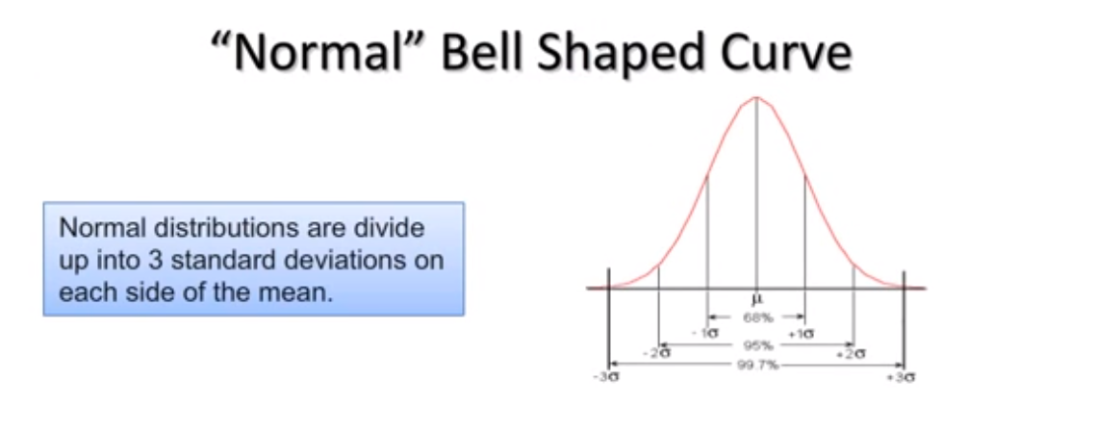

Slide 64
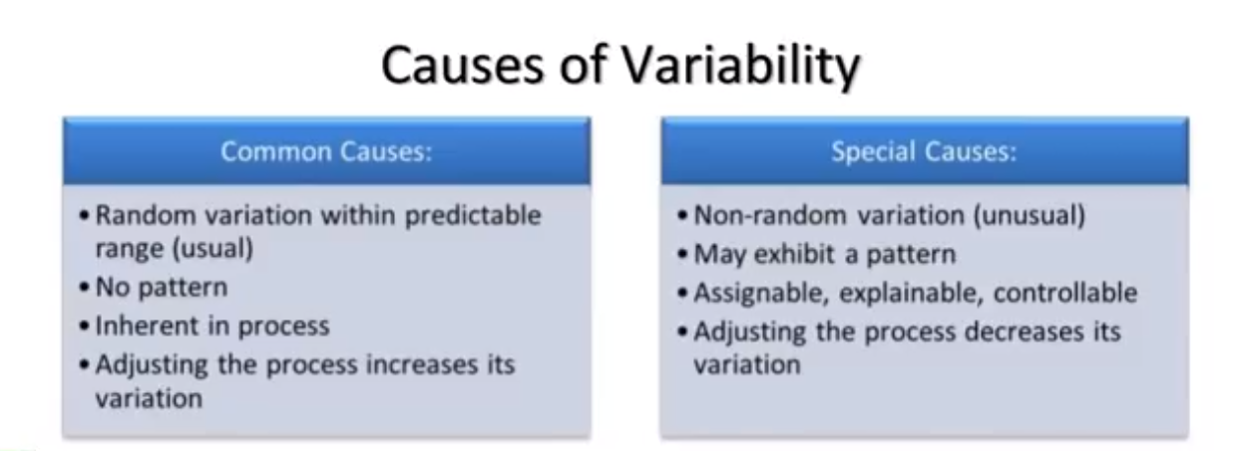

Slide 65
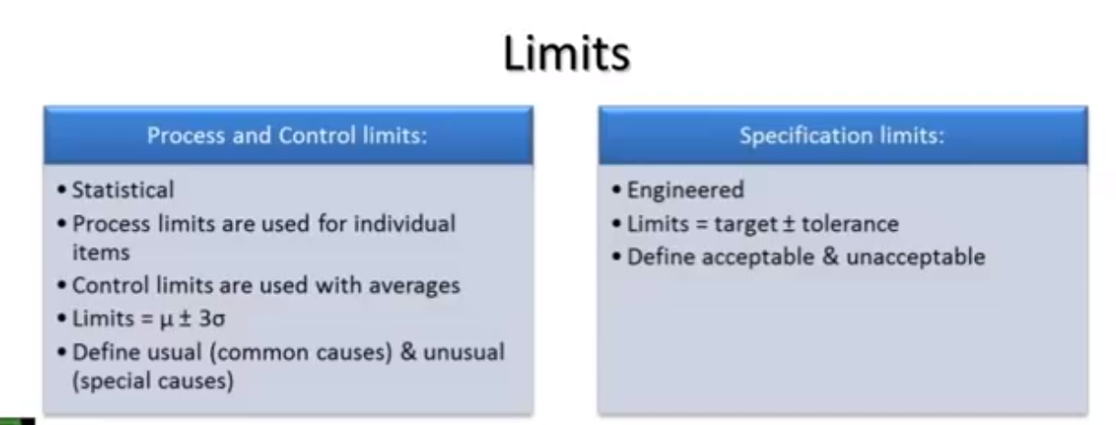

Slide 66
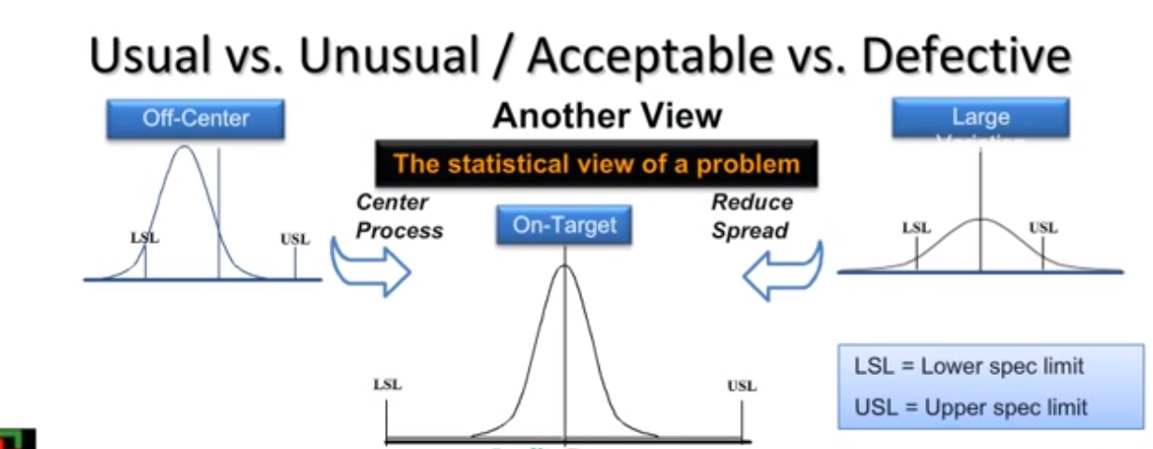

Slide 67
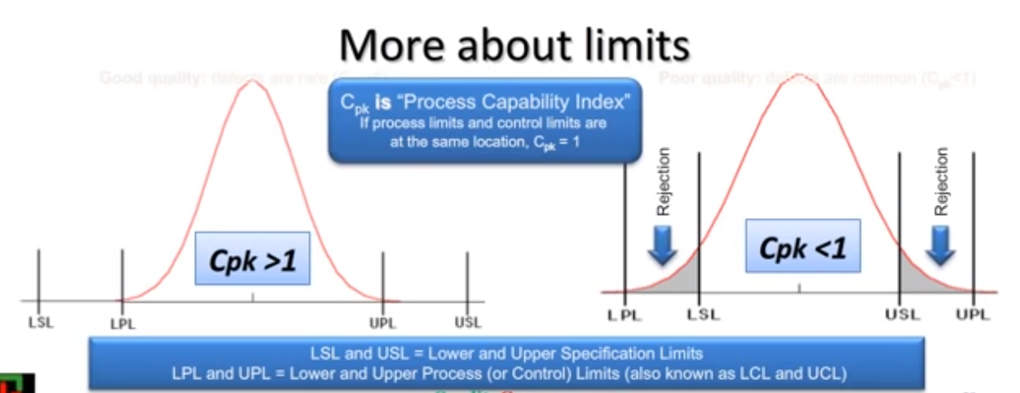

Slide 68
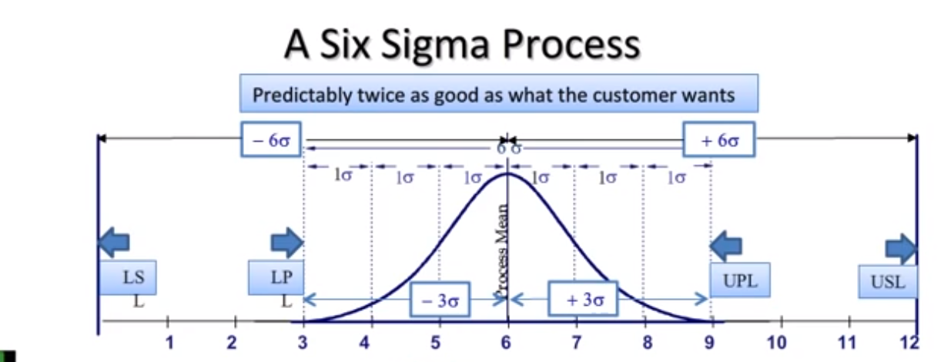

Slide 69
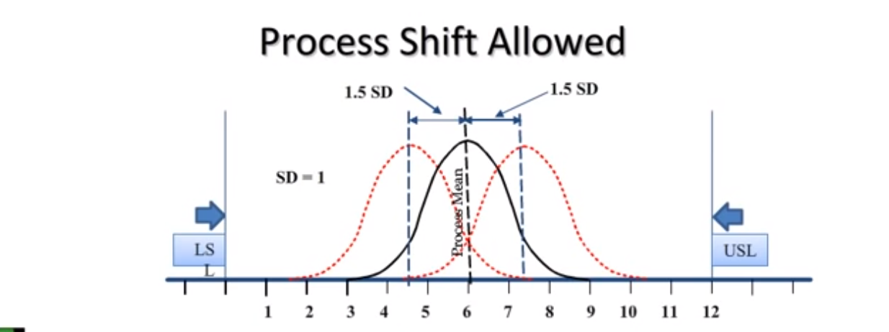

Slide 70
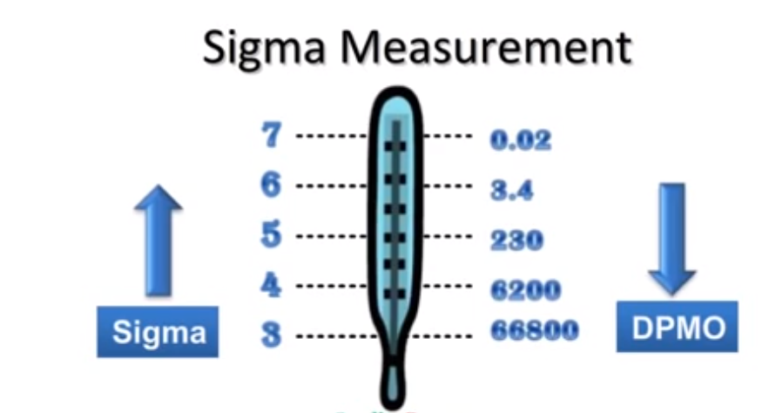

Slide 71
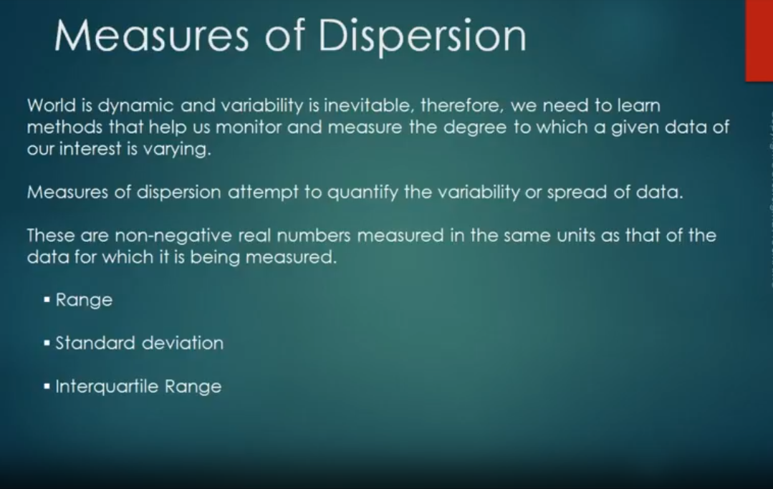

Slide 72
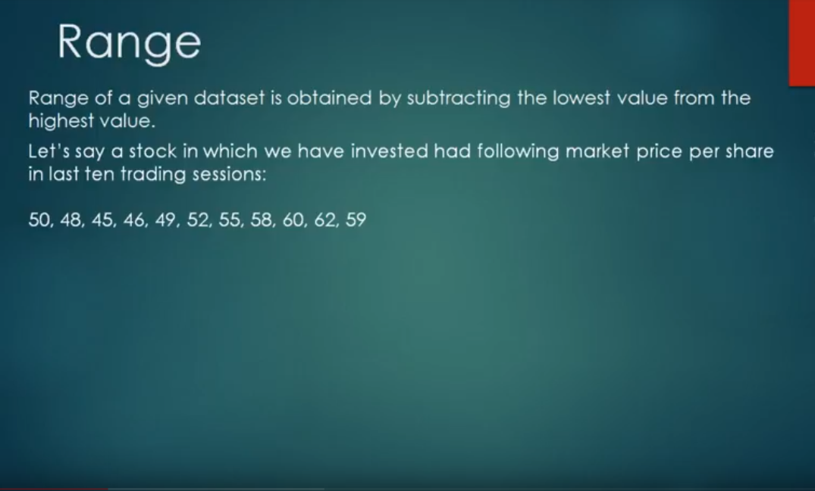
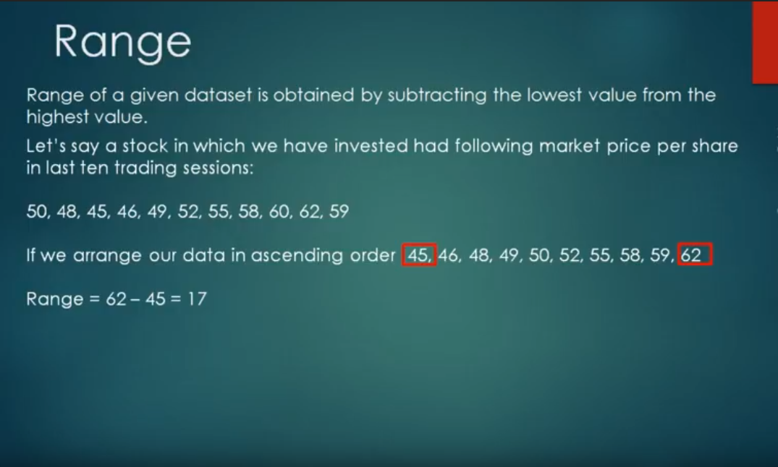

Slide 73
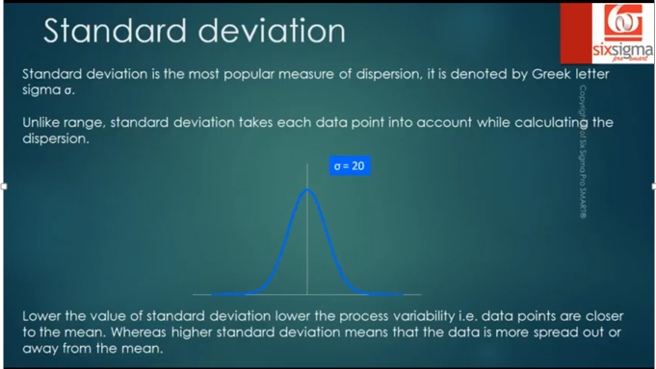
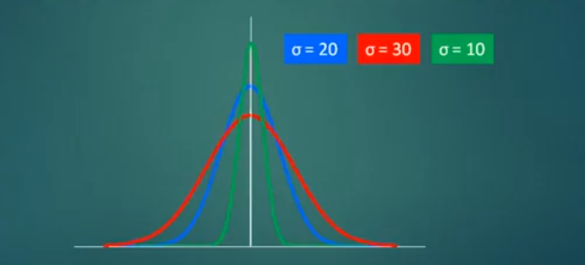
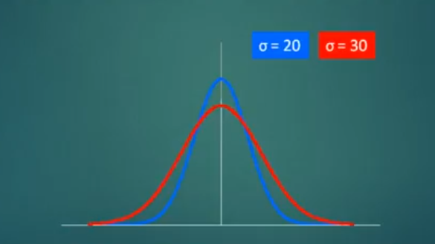

Slide 74

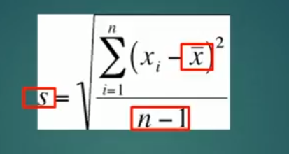
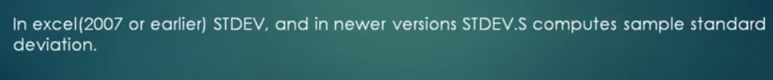

Slide 75
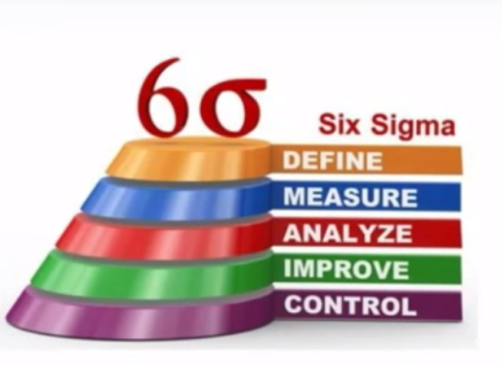

Slide 76
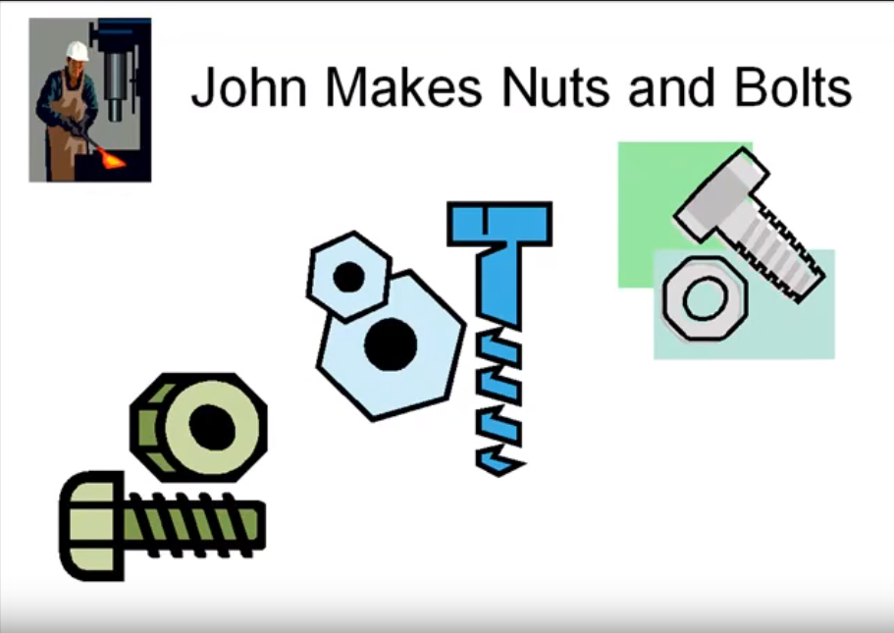

Slide 77
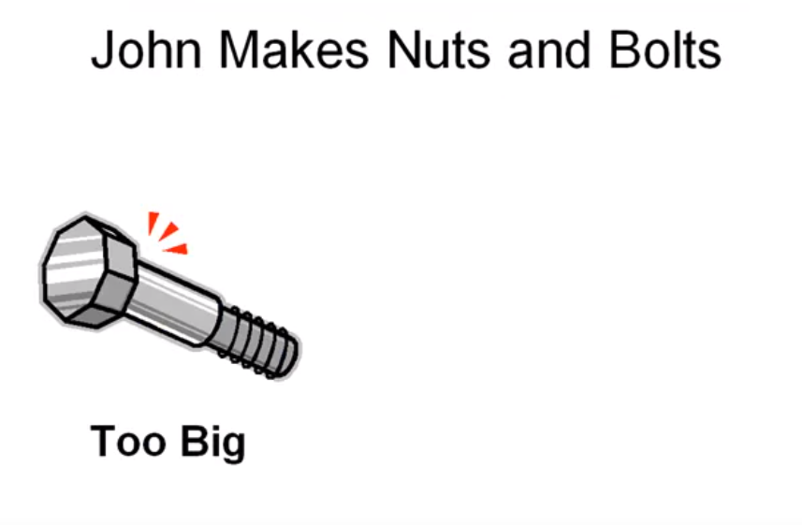

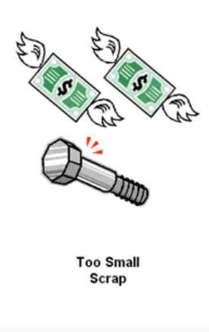



Slide 78








Slide 79


Slide 80
You can be like John

Slide 81


Slide 82


Slide 83


Slide 84


Slide 85



Slide 86


Slide 87


Slide 88

Problem
Management

Slide 89


Slide 90


Slide 91


Slide 92


Slide 93

Many Software helps you
In your work in Six Sigma

Slide 94






Slide 95
Background and
Meaning of Six Sigma

Slide 96


Slide 97


Slide 98






Slide 99

Improving existing
business processes
Creating new Products and Process design

Slide 100


Slide 101


Slide 102


Slide 103


Slide 104


Slide 105


Slide 106


Slide 107


Slide 108


Slide 109


Slide 110


Slide 111


Slide 112


